Slide 1

Dr. Kimman Lui
Lecture : 2:30 – 4:30 PM (Y412)
Tutorial : 4:30 – 5:30 PM (Y412 Or Lab Room)

Slide 2

About this course
Do you know what this course is about?
What would you expect from this course?
How much do you know about software engineering?

Slide 3

Assessment
Group Project – 20 %
Group Presentation – 15 %
Individual Assignment – 10 %
Exam – 55 %

Slide 4
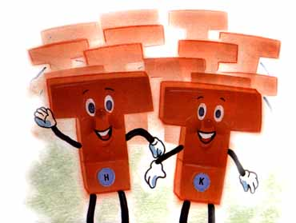
Teaching Plan
Introduction to SE, SPM, ASD
Software Process and People
eXtreme Programming
Agile Software Development Principles and Scrum
Pair Programming
Test Driven Development
Software Design
Agile Teaming
Repeat Programming
CMM and eXtreme Programming
Open Source Software Development and ASD
Presentation
Exam Review

Slide 5

Class Organization
Lecture
Workshop/Tutorial

Slide 6

Group Presentation
Tell us what you have learned in the project in 20-25 minutes
  Share your findings
  Discuss whether it will be
  practical at your workplace
  Q/A
  5 Nov 2010**
** Tentative

Slide 7
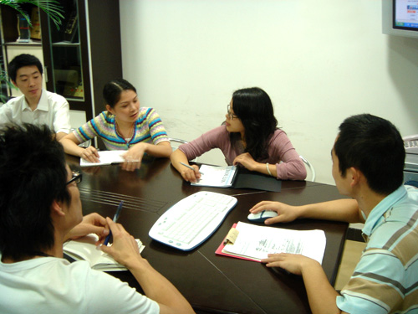
Group Project
Topic
  Use Pair Programming Technique to Build a Program
A group of 4 Students
Each group should find its collaborative team.
Deadline: 19 Nov 2010

Slide 8
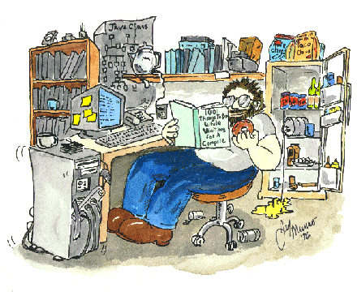
Individual Assignment
  Collect the results from other groups
  Write up a report in 1000-1200 words
  Provide your thoughts on what should be done best to adopt pair programming at your workplace
  Deadline: 28 Nov 2010

Slide 9

Report
.doc (NOT .docx nor .pdf)

Slide 10

Closed Book Exam
2 Hours
MC
Short Questions
(Word-limited Answers)
Case Studies
(and/or Long Questions)

Slide 11


Textbook
Software Development Rhythms
K M Lui and K C C Chan

Slide 12
PPT
The lecture notes will be uploaded to WebCT before Sunday 23:59 PM.

Slide 13

Lecture Notes
points
explanations

Slide 14

Late Submission
To be fair for students who hand in their assignments on time
5 marks deduced for one day
6 for two
7 for tree
8 for four
9 for five
10 for more than five
Applications for exemption from penalty must be made in writing (e.g. email) with a proof (e.g. a copy of air tickets)

Slide 15

Plagiarism
Plagiarism is not acceptable as part of University policy.
Plagiarism includes:
  1) submitting work that was performed by another individual, and;
  2) improperly referencing material from published resources.
Talk to me if you are unsure
about how to reference material.

Slide 16

Other Requests
Please demonstrate your professionalism by respecting the comments and questions of your classmates, and by silencing all cellular phones and pagers.
Please bring all relevant material to each class.
Please feel free to contact me with questions regarding course material.
Please allow me to make minor adjustments to the syllabus, as circumstances require.

Slide 17

Exam Tips
Does a trading company need a computer system?
Answer
I think a trading company needs a good computer system to support their business so that people in the company can work closely together and access their information any time.
Answer
To integrate different functions of business processes, ERP is indispensable to share information with co-workers, control collaborative workflow, assess real-time information
→ Answer the questions using technical vocabulary

Slide 18
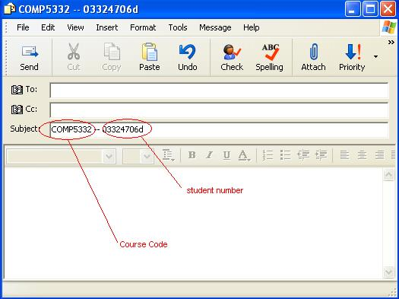
Email to me
Please write down your course code and student number so that I can response to you earlier.
cskmlui@comp.polyu.edu.hk

